Slide 1
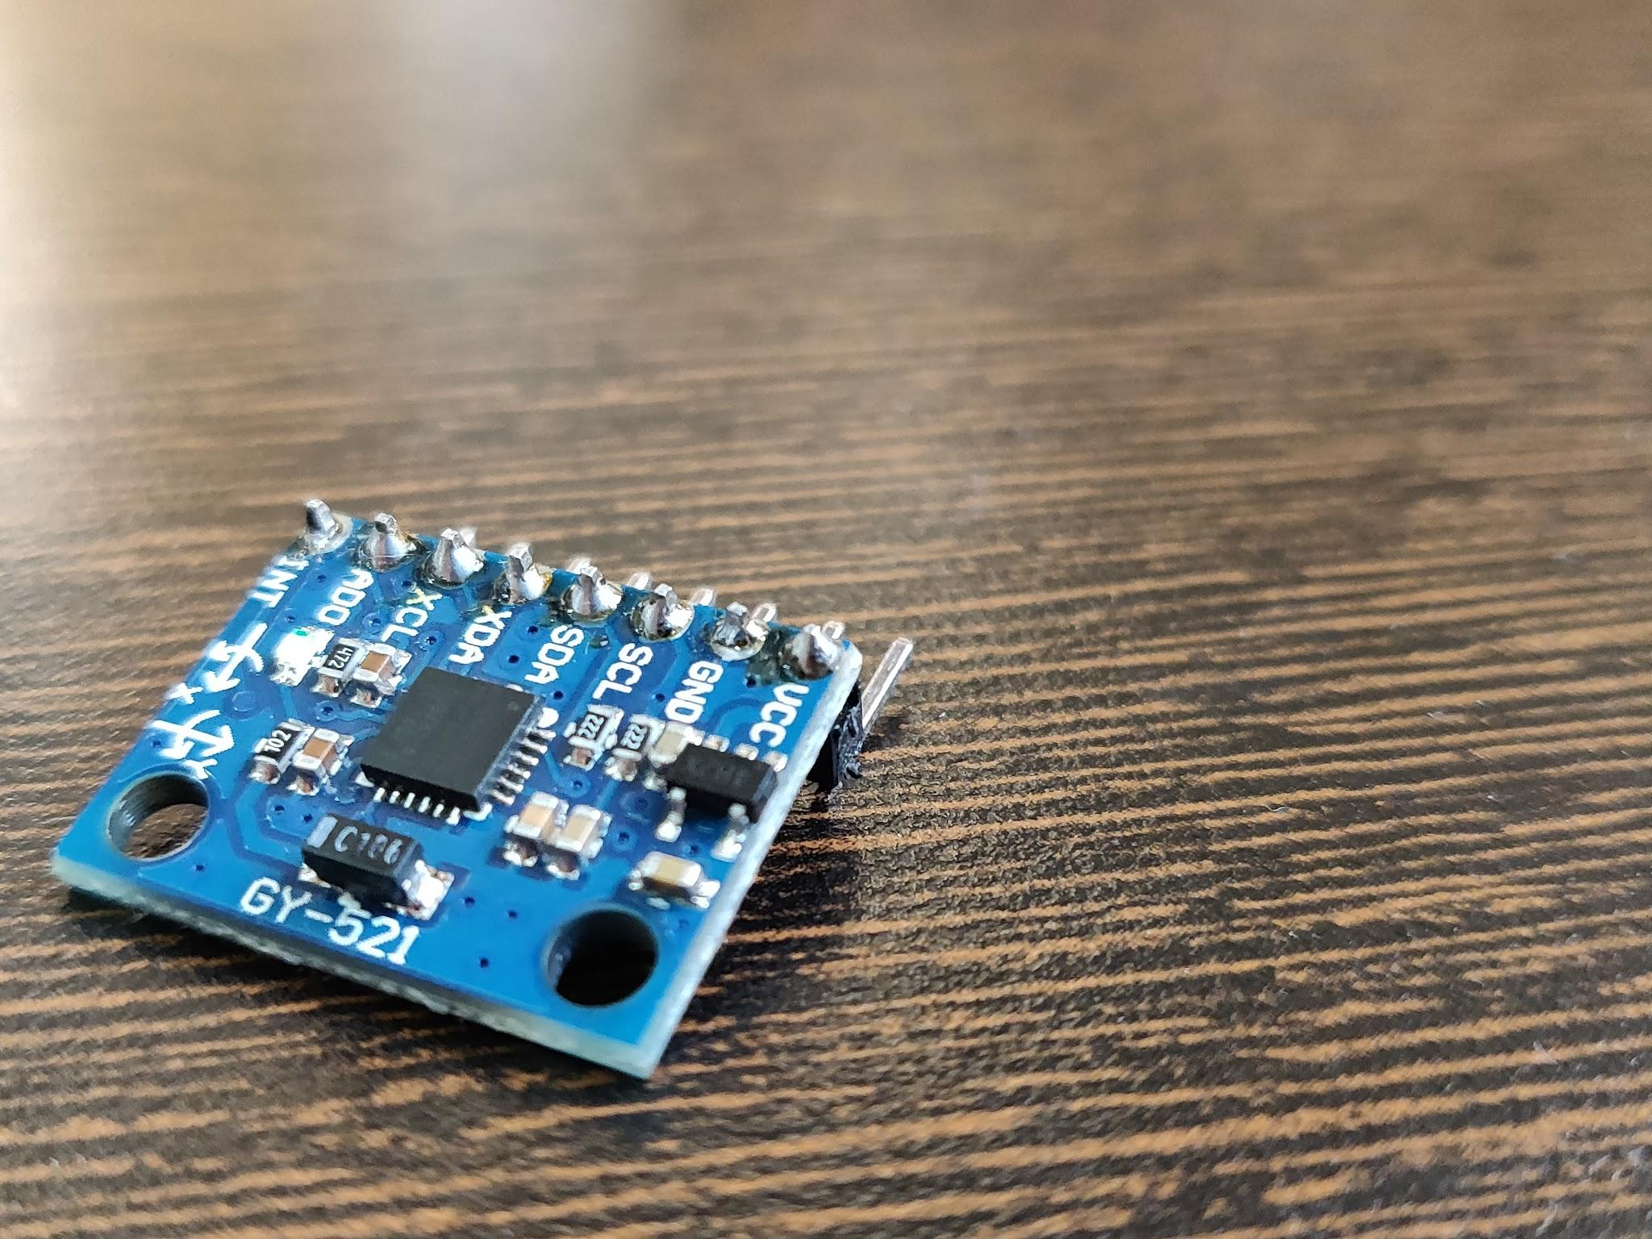

IIT KANPUR AE 251
Wifi cursor control using IMU sensor
By
Abhijeet(170015)
Naveen Balaji(170426)
Mataria Pence Jagatkumar(170382)

Slide 2
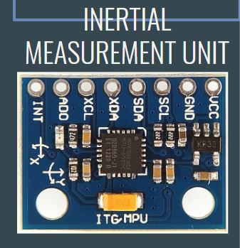
IMU
How do you think of getting aircraft’s acceleration or orientation?
(3A) ACCELEROMETER
(3A) GYROSCOPE
(3A) MAGNETOMETER
ANGULAR VELOCITY
POSE
ORIENTATION
LINEAR ACCELERATION

Slide 3
ACCELEROMETER
Micro-electro-mechanical Systems (MEMS) Technology.
An accelerometer is an electromechanical device that is used to measure acceleration and the force producing it.
Most commonly used MEMS Accelerometer are of capacitive type.
Based on F=M*a
Notes:
MEMS: smaller chip size, can be clubbed with other electronics

Slide 4
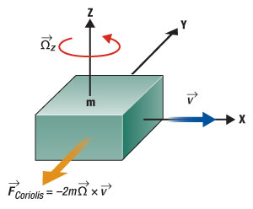
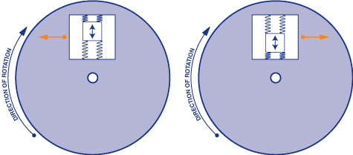
GYROSCOPE
Micro-electro-mechanical Systems (MEMS) Technology.
An Gyroscope is an electromechanical device that is used to measure angular velocity.
Based on Coriolis Effect.
Notes:
MEMS: smaller chip size, can be clubbed with other electronics

Slide 5
PROJECT
Controlling the mouse by using IMU sensor
Micro-Controller
+
WIFI module
IMU
DATA
Transformation
Mapped Data
Cursor Movement
PC
Notes:
MEMS: smaller chip size, can be clubbed with other electronics

Slide 6
REFERENCES
ACKNOWLEDGEMENTS
http://www.instrumentationtoday.com/mems-accelerometer/2011/08/
http://www.kostasalexis.com/uploads/5/8/4/4/58449511/06_inertialsensors.pdf
https://learn.sparkfun.com/tutorials/gyroscope/all
Aeromodelling Club, IIT Kanpur
Electronics Club, IIT Kanpur
Notes:
MEMS: smaller chip size, can be clubbed with other electronics

